Slide 1


CAPSTONE FINAL REVIEW
FloodGuard AI: Early Warning and Smart Resource Allocation for Urban Floods
guided by: Dr. M.K.Nagarajan

Slide 2

TEAM MEMBERS
S SANJAY KUMAR – 99220040354
P AKILAN – 99220040235
P PANDI VEER VISWA – 99220040342
M MIDHUN– 99220040307

Slide 3

PROBLEM STATEMENT
Urban and river flooding causes severe damage to life and infrastructure.
Existing systems depend on limited meteorological data and provide delayed alerts.
Lack of real-time monitoring and accurate prediction.
No integrated system combining sensor data, weather data, and alerts.
Need for an intelligent, automated flood early warning system.

Slide 4
LITERATURE SURVEY
SL.NO | TITLE | YEAR | AUTHOR | ADVANTAGES | DISADVANTAGES
1 | Rainfall Threshold Approach for Flash Flood Early Warning | 2018 | D. T. Nguyen et al. | Simple to implement; effective for localized flash flood alerts. | High false alarms; fails to consider land use and soil moisture conditions
2 | Physically Based Hydrological Modeling Using HEC-HMS for Flood Forecasting | 2019 | A. Sharma and R. Patel | Provides accurate discharge prediction; supports real hydrological interpretation. | Requires extensive calibration; heavy computational load
3 | Flood Mapping Using Sentinel-1 SAR Data and GIS | 2020 | L. D. Singh et al | Provides large spatial coverage; effective under cloud conditions. | Complex preprocessing; limited real-time capability

Slide 5
LITERATURE SURVEY
SL.NO | TITLE | YEAR | AUTHOR | ADVANTAGES | DISADVANTAGES
4 | GIS-Based Flood Risk Assessment in Urban Catchments | 2020 | H. Zhang and M. Kim | Identifies vulnerable zones visually; supports evacuation planning | Relies on static data; requires frequent GIS updates.
5 | Machine Learning for Flood Prediction Using Random Forest Model | 2021 | S. Choubey and T. Bose | High prediction accuracy; handles multi-feature datasets, | Needs large data volume; model prone to overfitting
6 | Deep Learning-Based LSTM Model for River Flood Forecasting | 2021 | K. Lee et al | Captures temporal rainfall trends effectively; suitable for sequence prediction. | Requires significant training data and high-end GPU resources

Slide 6
Existing System Overview
Traditional systems use:
Rainfall thresholds
Manual monitoring
Limitations:
High false alarm rate
Delayed alerts
Lack of real-time data integration
No intelligent prediction

Slide 7
PROPOSED SOLUTION
Integrates multi-source data (weather APIs, wildfire alerts, and geospatial services).
Generates a normalized flood risk score (0–100) based on weighted parameters
Implements real-time alert streaming using Server-Sent Events (SSE).
Built with a modular, scalable design to support future IoT and ML model extensions.
Target users: Disaster Management Authorities, Municipal Corporations and Urban Planners, Local Communities and Citizens

Slide 8
Hardware and Software Requirements
Hardware Requirements:
Arduino / ESP32 microcontroller
HC-SR04 Ultrasonic Sensor
Power supply system
Serial communication (USB)
Software Requirements
Python (Flask framework)
SQLite Database
OpenWeatherMap API
Twilio API (SMS alerts)

Slide 9
Modules
Data Acquisition Module
Collects weather data (API)
Reads sensor data (water level)
2. Risk Calculation Module
Calculates flood risk using:
70% water level
20% cloud factor
10% wind factor

Slide 10
Modules
3. Alert Module
Sends SMS alerts using Twilio
Triggered when threshold exceeded
4. Prediction Module
Uses regression to predict future water levels
5. Visualization Module
Dashboard + heatmap display

Slide 11
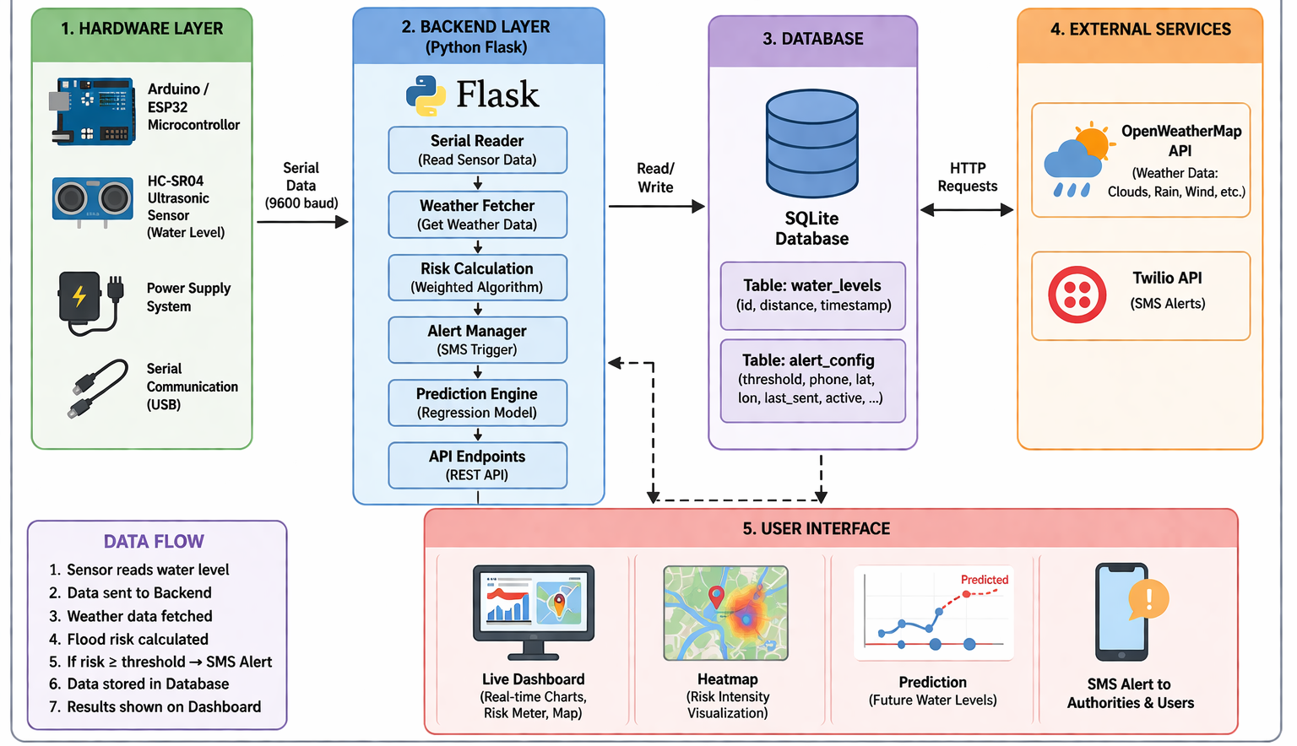
Overall Architecture

Slide 12
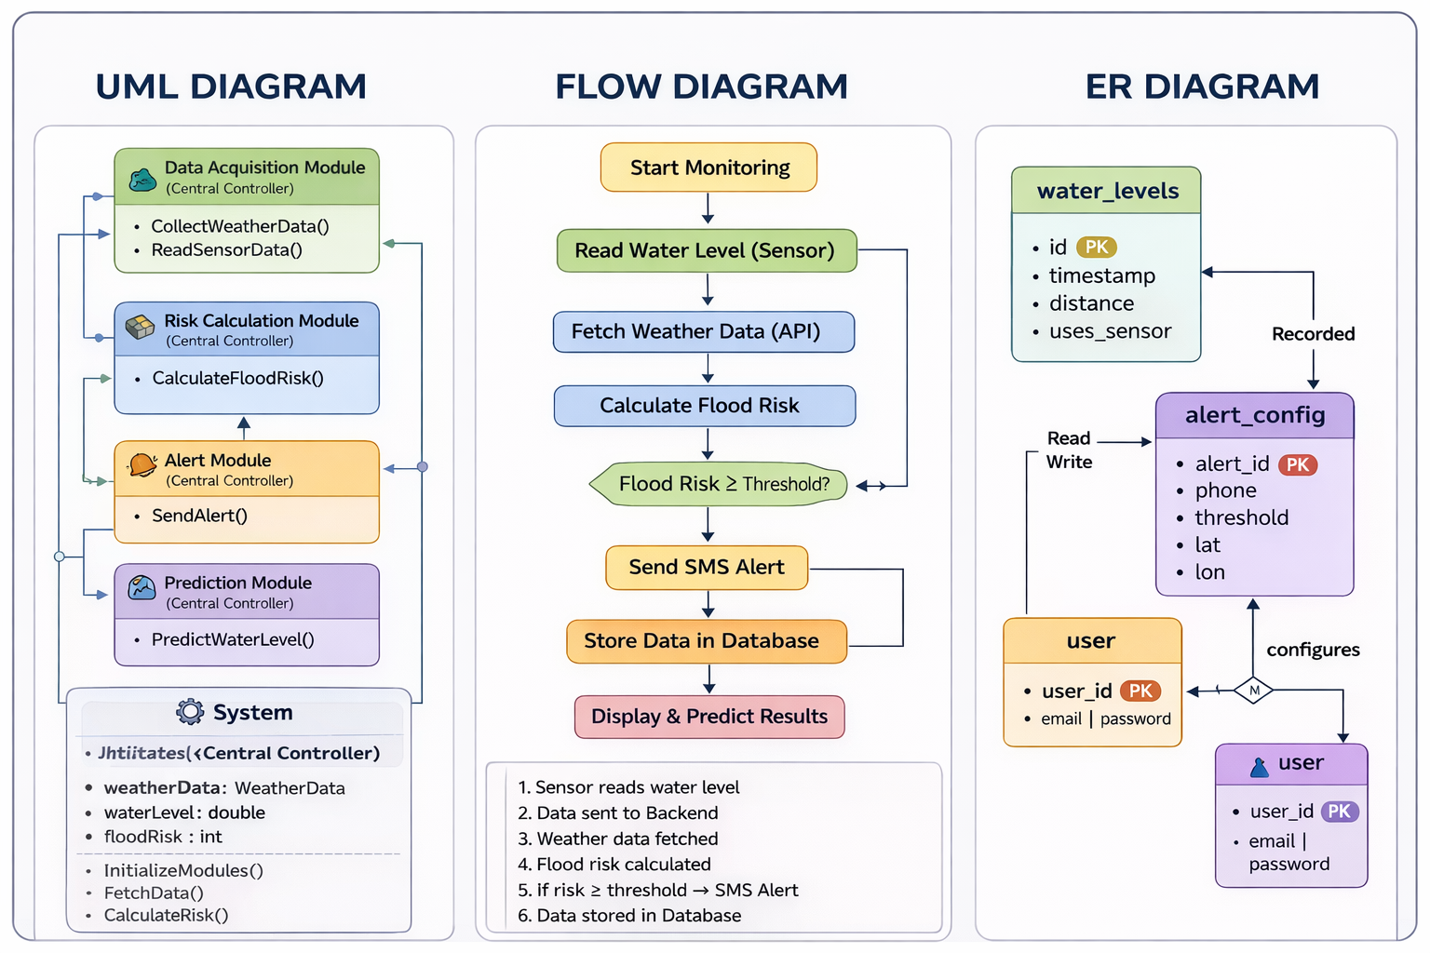
Flow Diagram, ER Diagram, and UML Diagrams

Slide 13
Results & Discussion
System response time: ~2.1 seconds
Real-time alerts using streaming
Accurate integration of multiple data sources
Prediction Accuracy: 87%
Early alerts: 4.5 hours earlier
False alarm reduced by 18%
Rainfall contributes highest risk (~52%)
Wildfire data improves accuracy by 12%

Slide 14
Conclusion
Developed intelligent flood monitoring system
Combines IoT, AI, and real-time data
Provides early warning and accurate prediction
Helps reduce disaster impact

Slide 15
Future Enhancements
Integration with IoT sensors (river/dam level)
Advanced ML models (LSTM, Deep Learning)
Mobile application development
Government disaster system integration

Slide 16
References
AI-based flood forecasting models – IEEE
IoT-enabled flood monitoring systems – IEEE
Satellite data in flood prediction – IEEE
Machine learning in flood forecasting – IEEE

Slide 17
Publications
Submitted
Papers submitted to conferences for review.
Accepted
Accepted in IEEE ICECIT 2026 (Hyderabad, India)

Slide 18
THANK YOU

